Slide 1

PROJECT
LOGIINSIGHT 360
Smart Supply Chain & Logistics Insights

Slide 2


01
Introduction
02
Problem Statement
03
Proposed Solution
04
OLTP Databse
05
Datawarehouse
06
SSRS
Today’s Agenda
07
Power BI Dashboards
08
Website
09
Workflow& AI

Slide 3






MEET OUR
TEAM MEMBERS
MAMDOUH FAHEEM
MOHAMED AYMAN
SARAH ELSHENAWY
MARAM IBRAHIM
RAHMA OSAMA

Slide 4


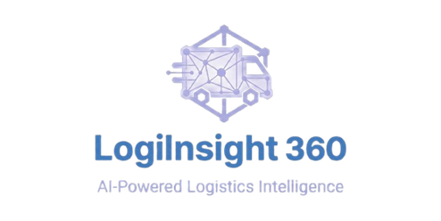
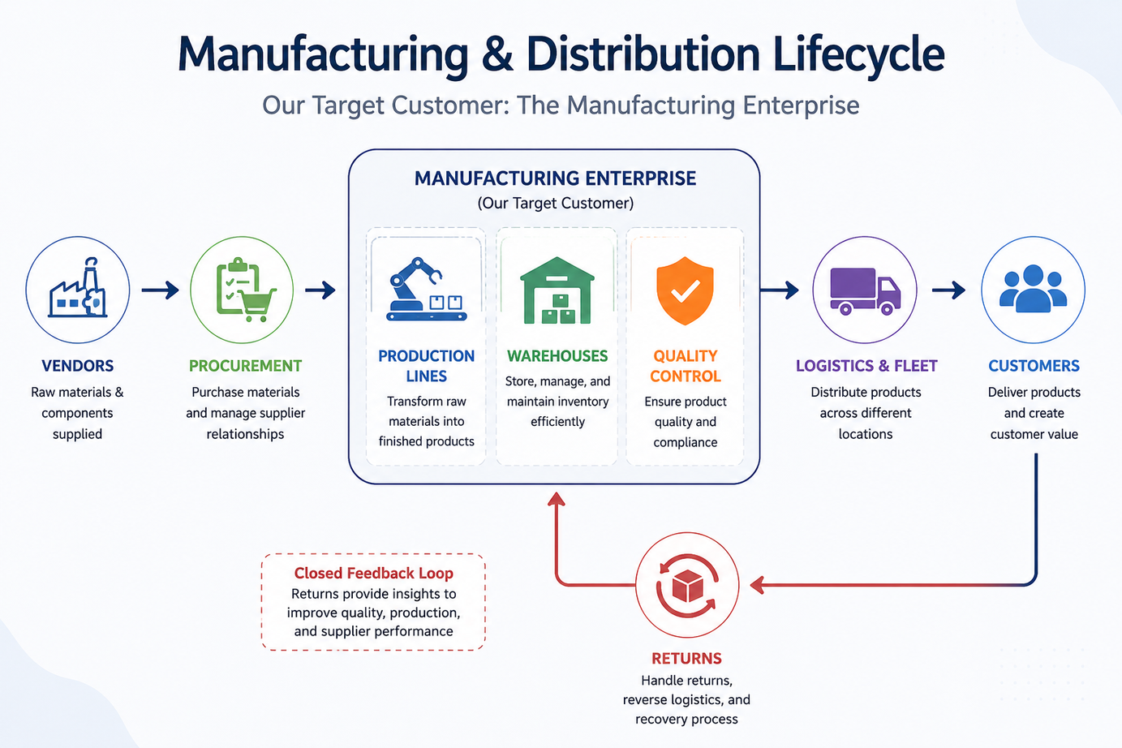
Manufacturing & Distribution Lifecycle

Slide 5
Problem Statement
ISOLATED ERP SILOS (SEPARATED MODULES)
THE OPERATIONAL DECISION GAP (THE BLIND SPOT)
UNEXPLOITED DATA & DISCONNECTED ROOT-CAUSES
In traditional ERP systems, every department operates in an isolated "Module" (Silo). Data is trapped inside Procurement, Warehouse, or Sales, with zero native horizontal integration, leading to communication lag and data fragmentation.
A massive visibility gap exists between the executive desk and the reality of the factory floor or the road. Decision-makers lack the power to connect immediate floor-level incidents (like a quality fail or fuel drop) to a broader corporate strategy in real-time.
Companies generate millions of rows of data across the cycle, yet they fail to leverage these numbers. They treat symptoms rather than root causes—such as failing to link a spike in Customer Returns (Logistics/Sales) back to a specific Vendor’s raw materials or a machine fault in the Production Line.

Slide 6

Proposed Solution
LogiInsight 360 – The Operating System for Supply Chains
01
Unified Data Hub
02
Real-Time BI
All modules (Procurement, Production, Warehouse, Fleet, Sales) connected to a single Azure SQL database.
20 Power BI dashboards providing live KPIs, heatmaps, and drill-through analytics.
03
AI-Driven Automation
04
SSRS Paginated Reports
GPT-4o agents autonomously detect high-risk events and generate mitigation workflows.
6 structured compliance-grade reports for managing the daily operational workflow, auditing supply chain transactions, and securing end-to-end documentation traceability

Slide 7


DATABASE DESIGN

Slide 8
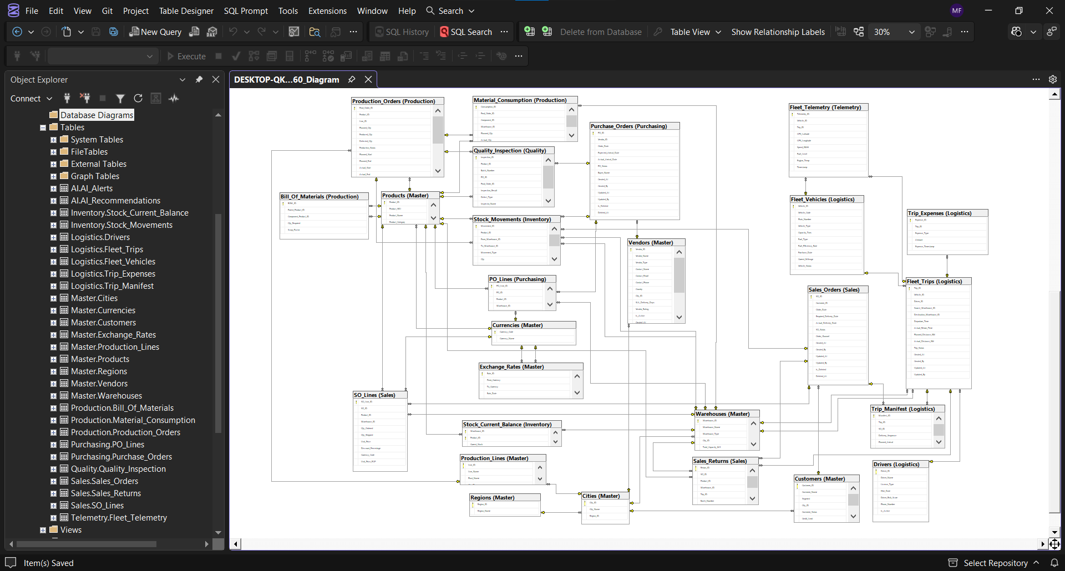

Slide 9

STORED PROCEDURES

Slide 10
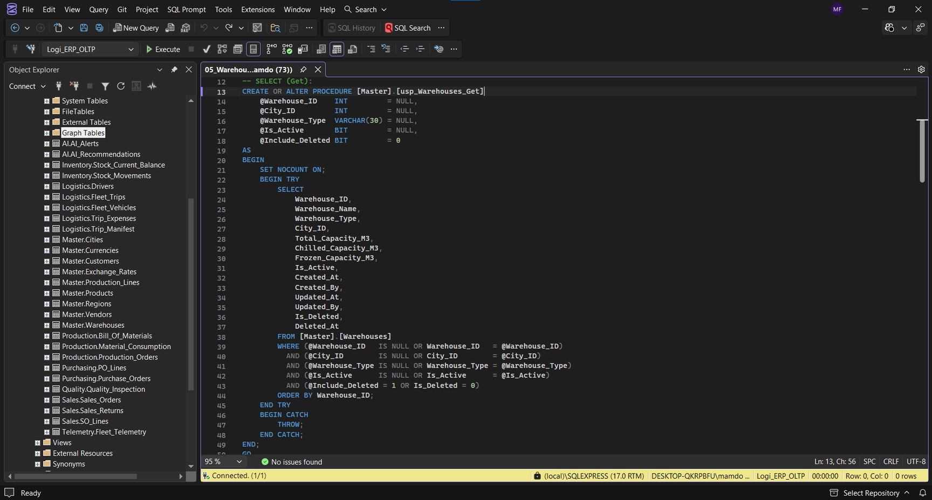
SELECT

Slide 11
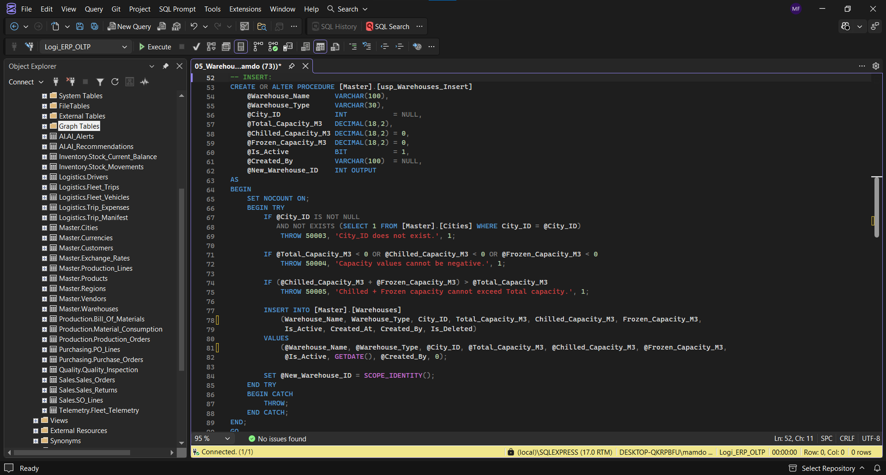
INSERT

Slide 12
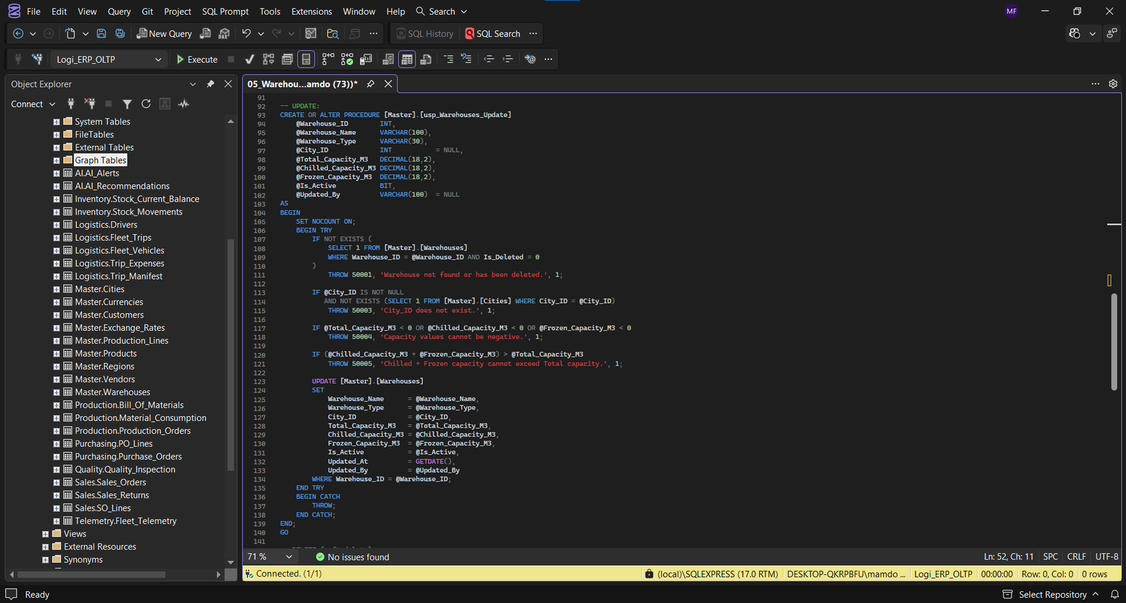
UPDATE

Slide 13
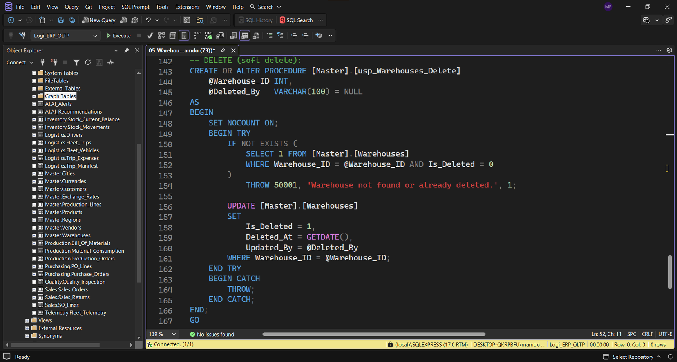
DELETE

Slide 14

DATA WAREHOUSE

Slide 15
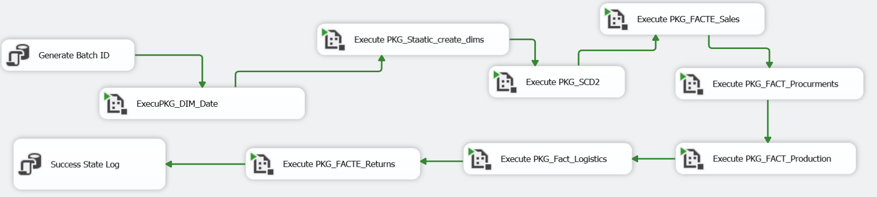
SSIS - MASTER PACKAGE FLOW

Slide 16
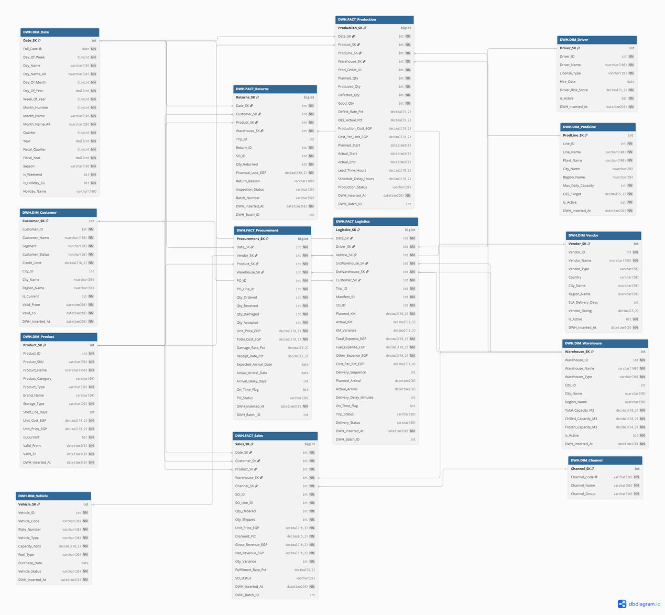
DATA WAREHOUSE DESIGN
9 Dimensions (Date, Customer, Product, Warehouse, Vendor, Driver, Vehicle, ProdLine, Channel).
5 Fact Tables (Sales, Procurement, Production, Logistics, Returns).

Slide 17
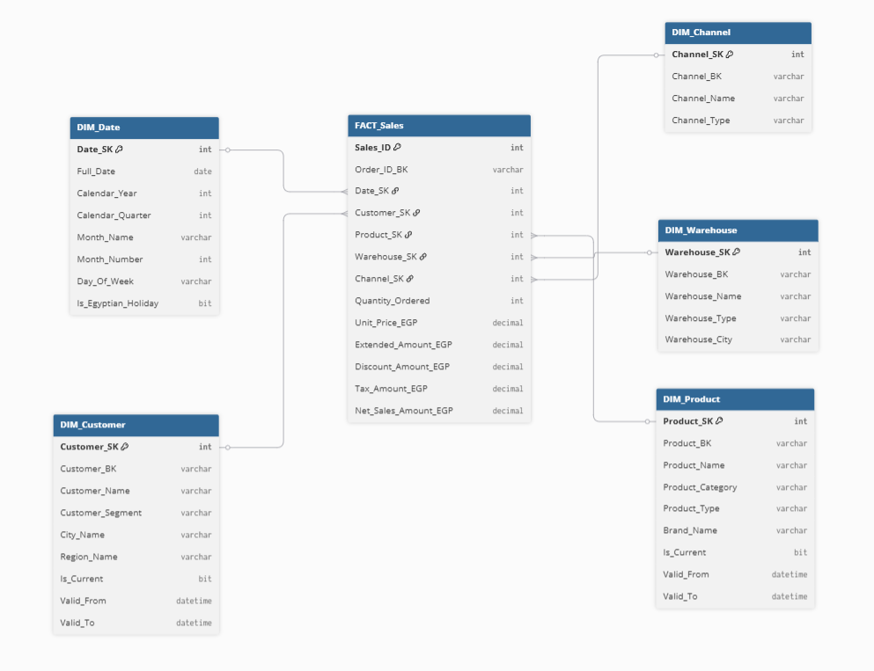
DATA WAREHOUSE DESIGN
Detailed Star Schemas
Sales Star

Slide 18
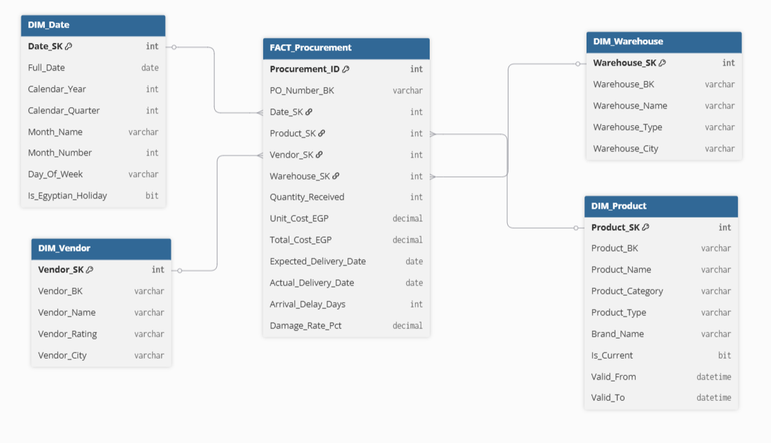
DATA WAREHOUSE DESIGN
Detailed Star Schemas
Procurement Star

Slide 19
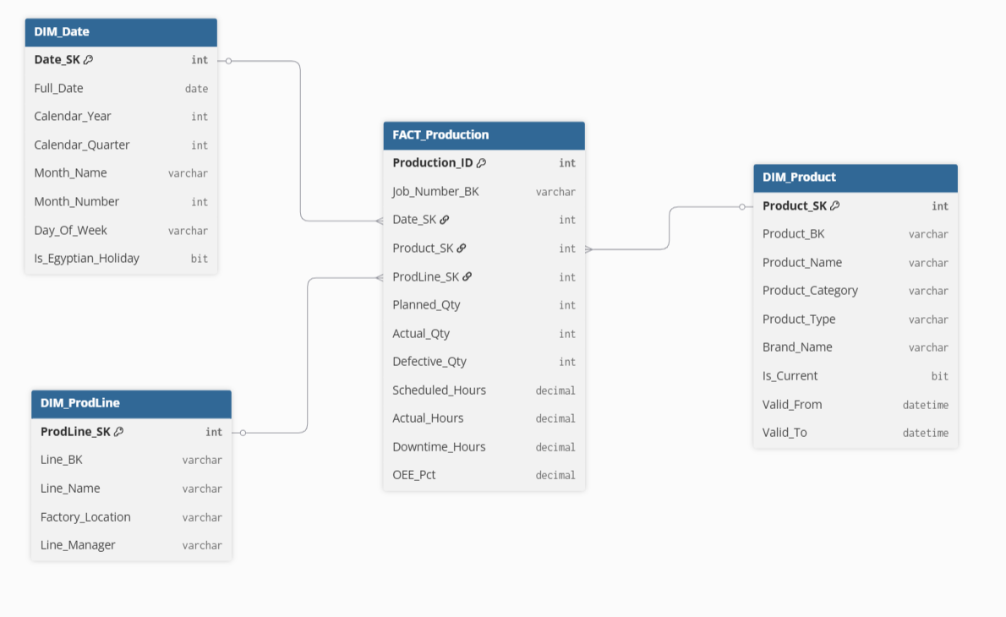
DATA WAREHOUSE DESIGN
Detailed Star Schemas
Production Star

Slide 20
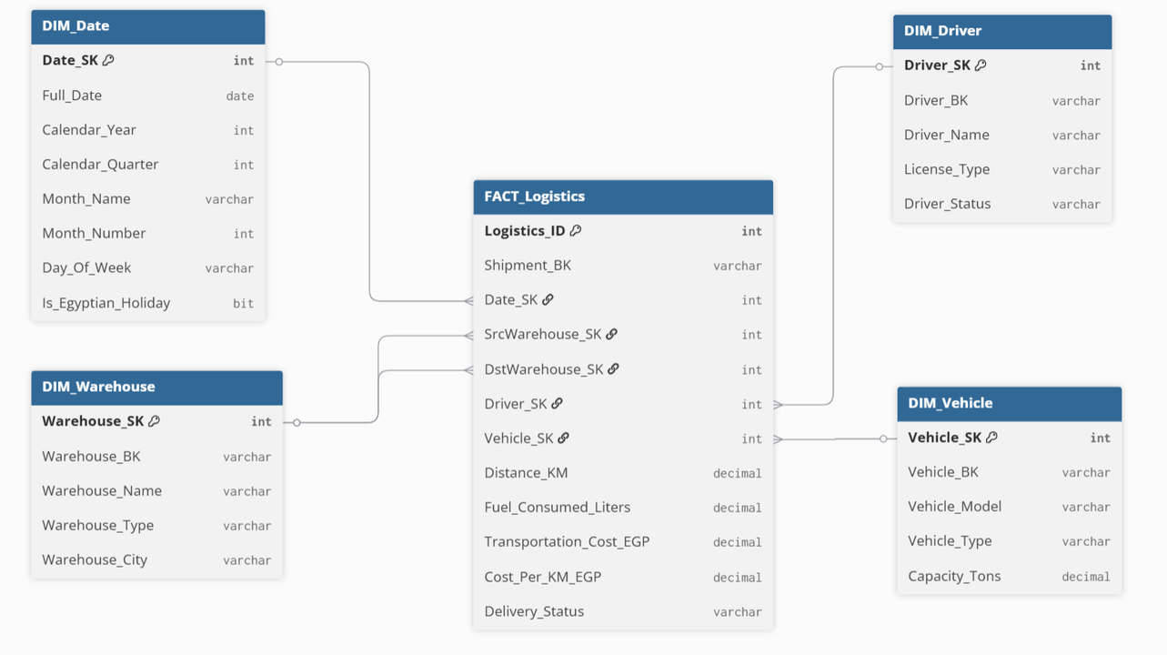
DATA WAREHOUSE DESIGN
Detailed Star Schemas
Logistics Star

Slide 21
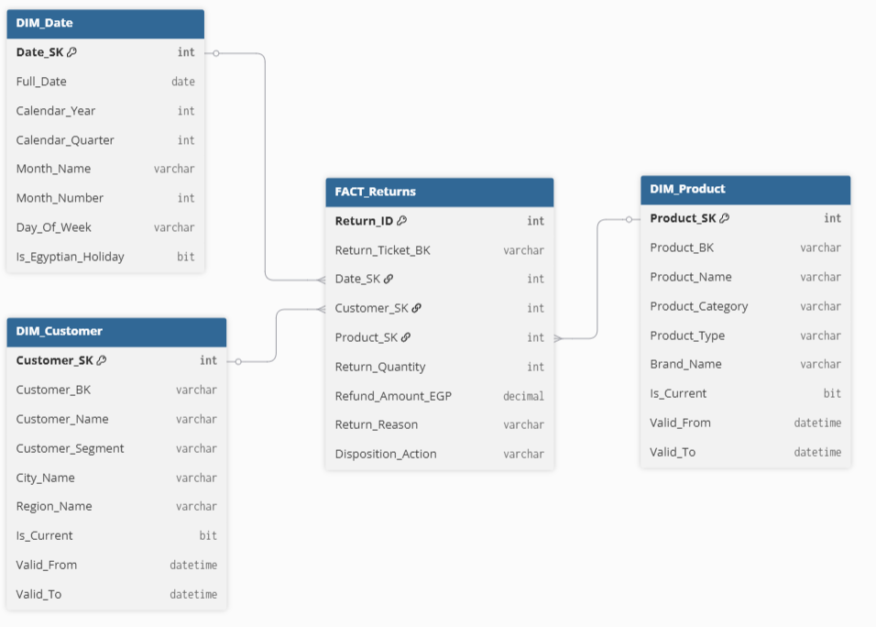
DATA WAREHOUSE DESIGN
Detailed Star Schemas
Returns Star

Slide 22

SSRS REPORTS

Slide 23
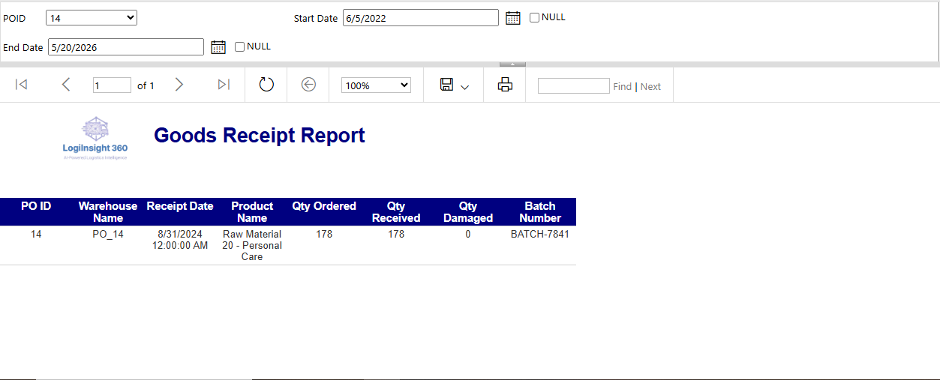


REPORT 01
FILTER PARAMETERS
POID
Start Date
End Date

Slide 24
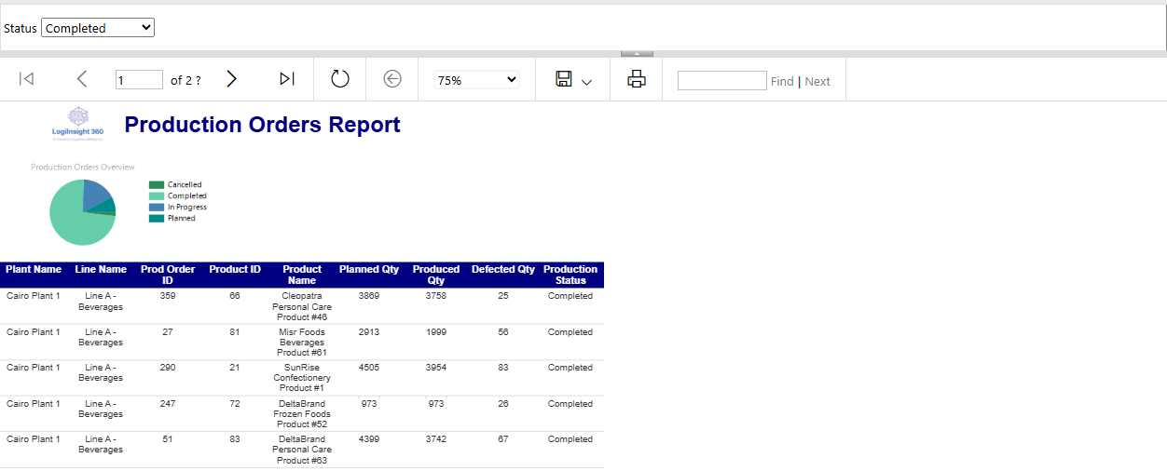
REPORT 02
FILTER PARAMETERS
Status

Slide 25
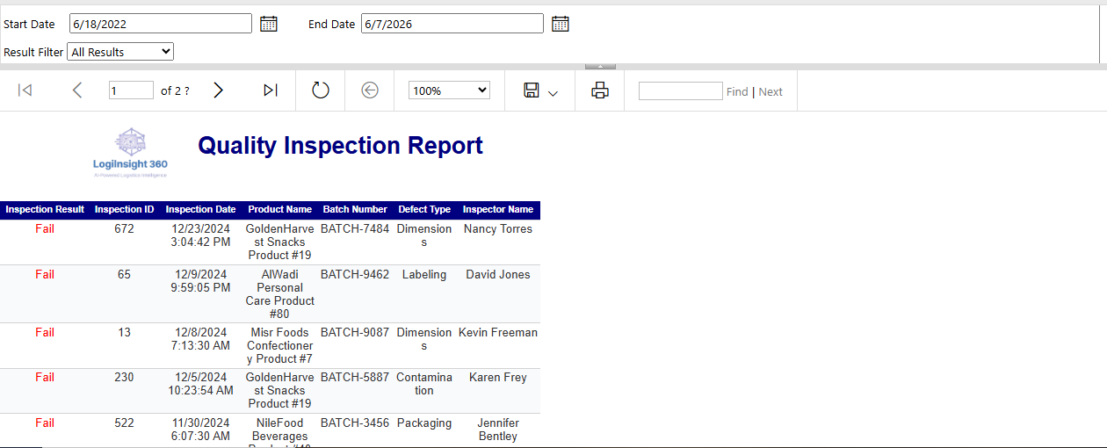
REPORT 03
FILTER PARAMETERS
Result Filter
Start Date
End Date

Slide 26
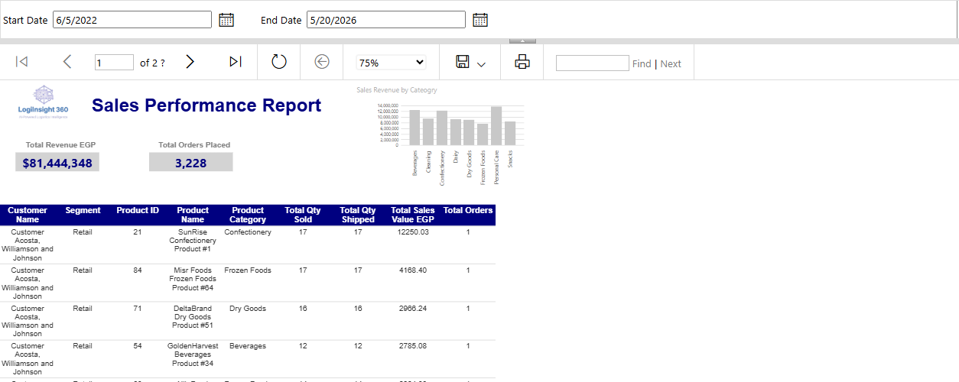
REPORT 04
FILTER PARAMETERS
Start Date
End Date

Slide 27
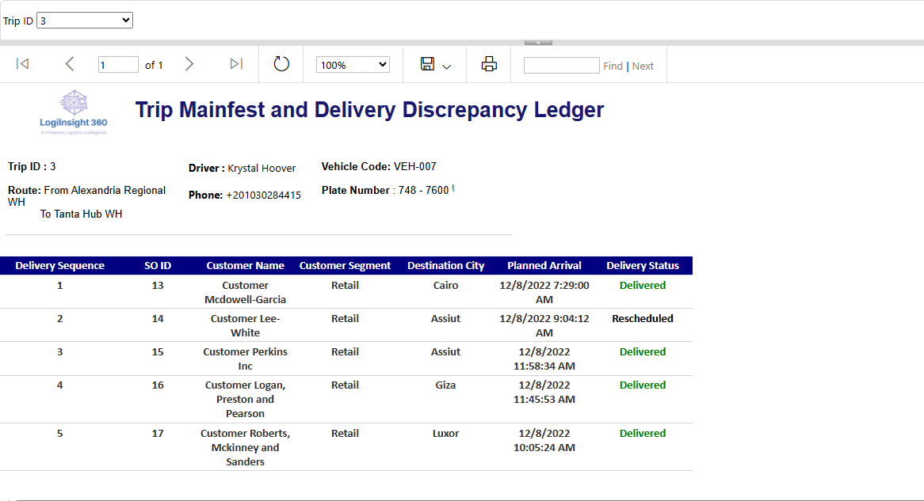
REPORT 05
FILTER PARAMETERS
Trip ID

Slide 28
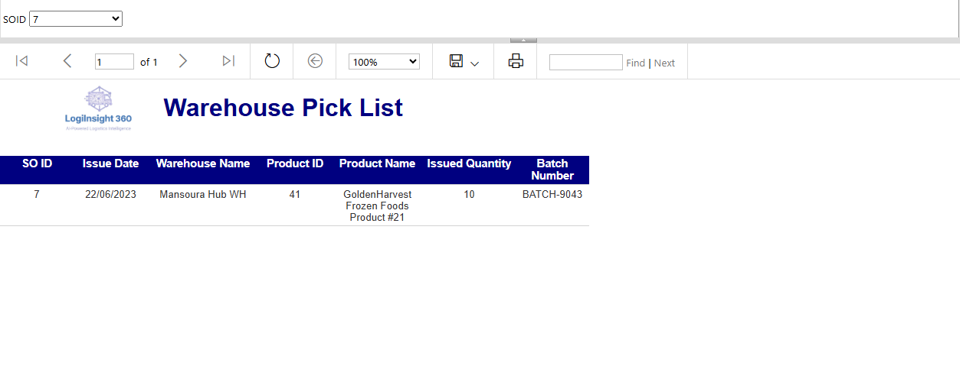
REPORT 06
FILTER PARAMETERS
SOID

Slide 29

POWER BI DASHBOARDS

Slide 30

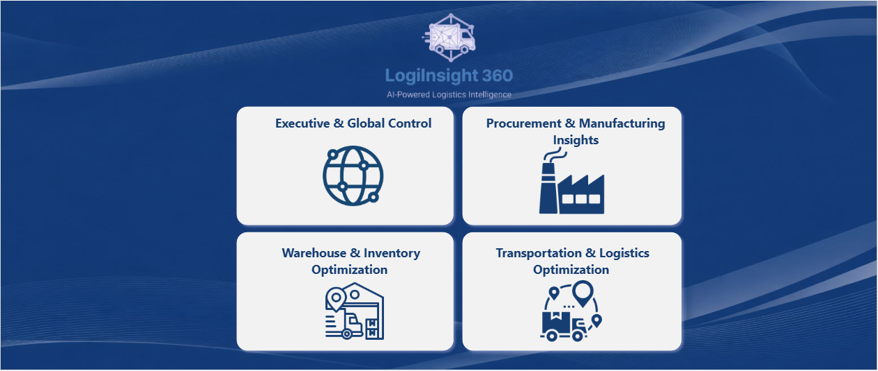

Slide 31
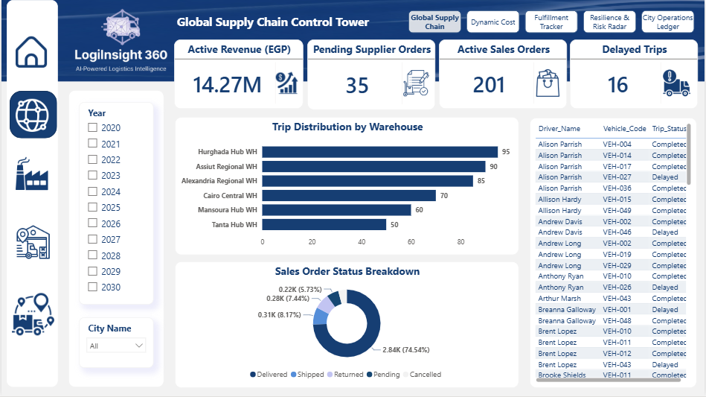

Slide 32
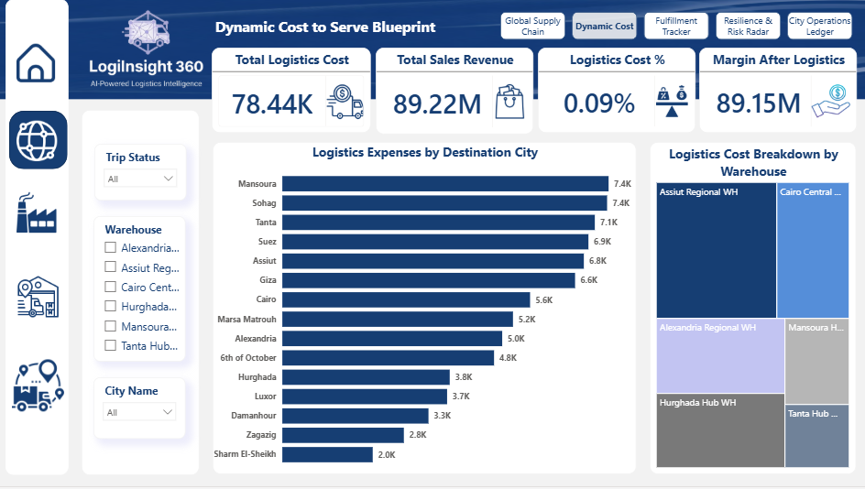

Slide 33
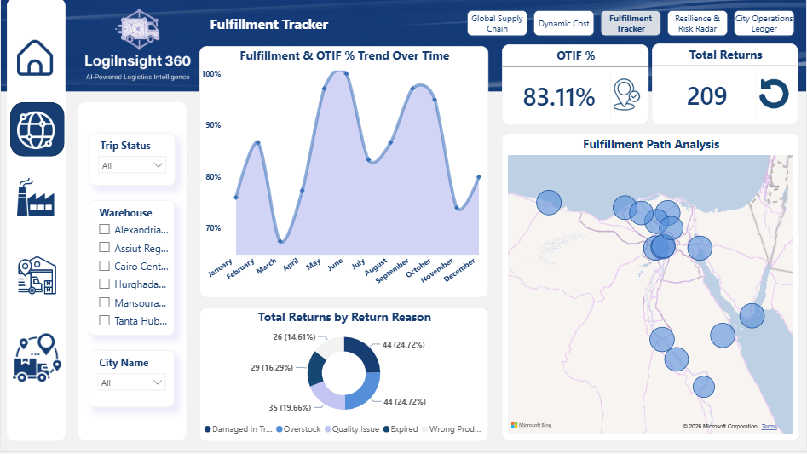

Slide 34
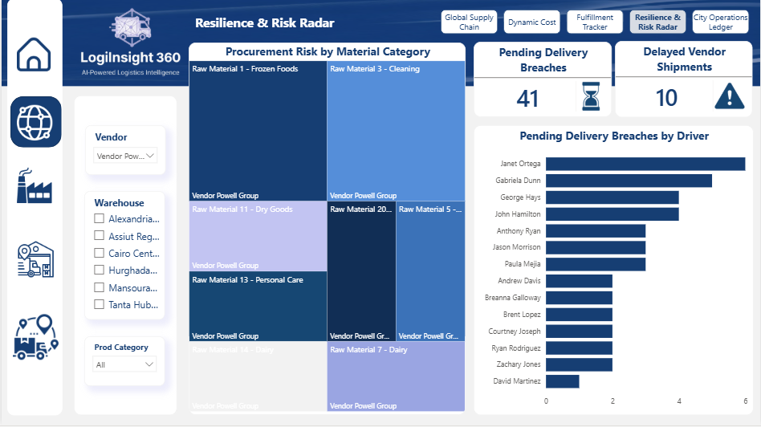

Slide 35
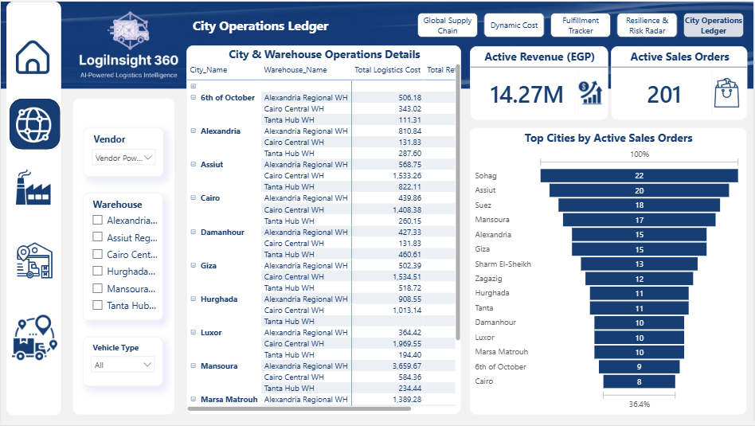

Slide 36
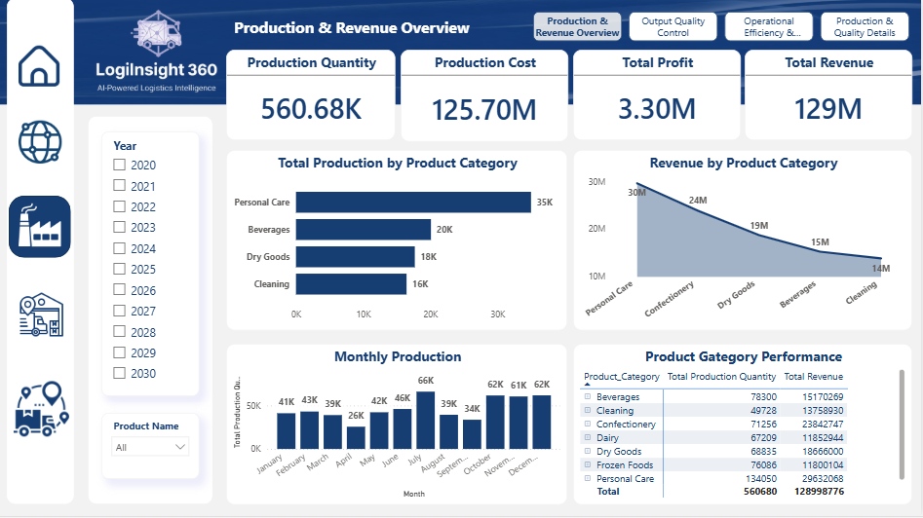

Slide 37
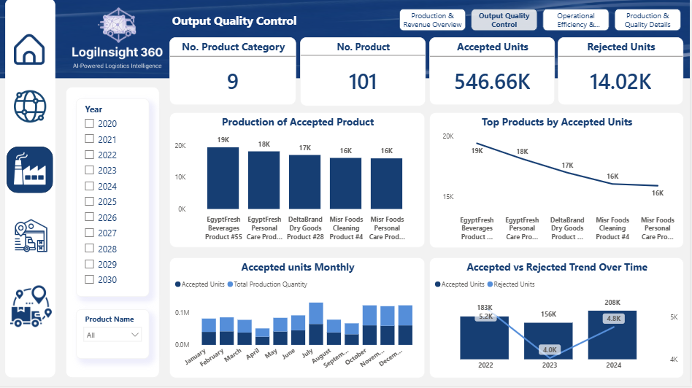

Slide 38
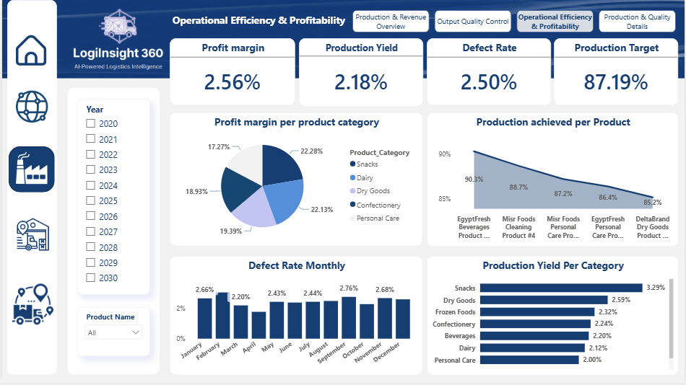

Slide 39
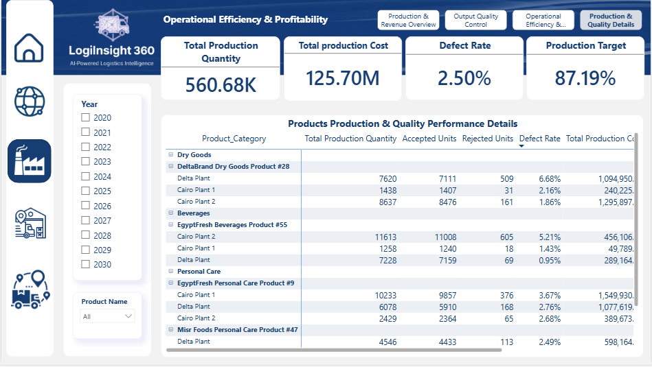

Slide 40
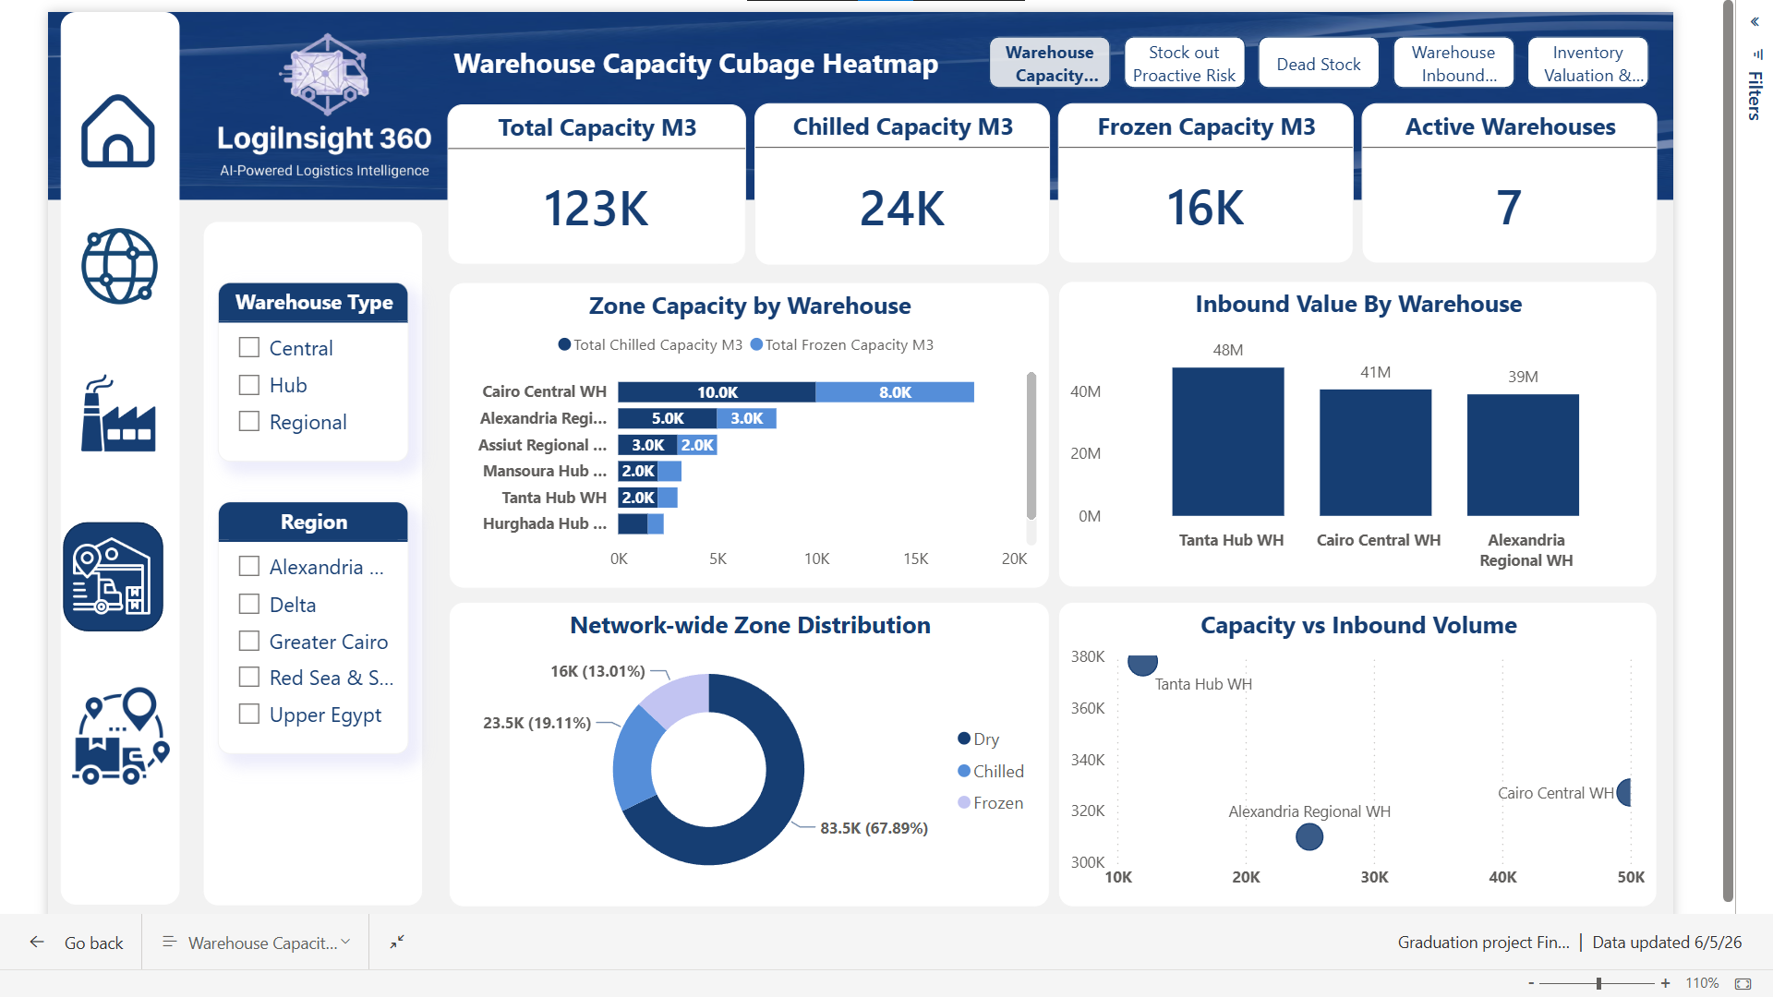

Slide 41
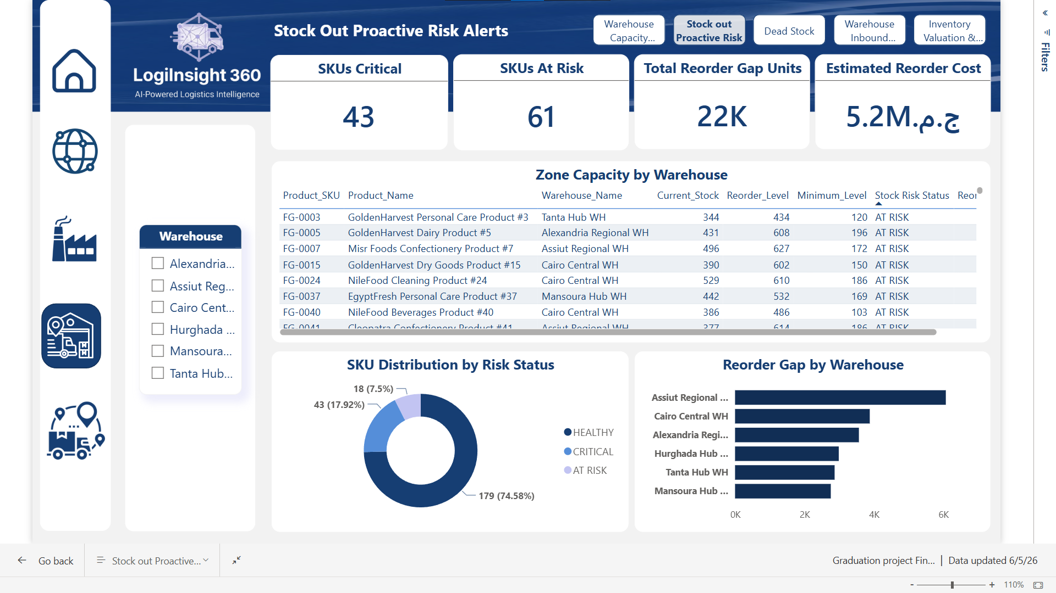

Slide 42
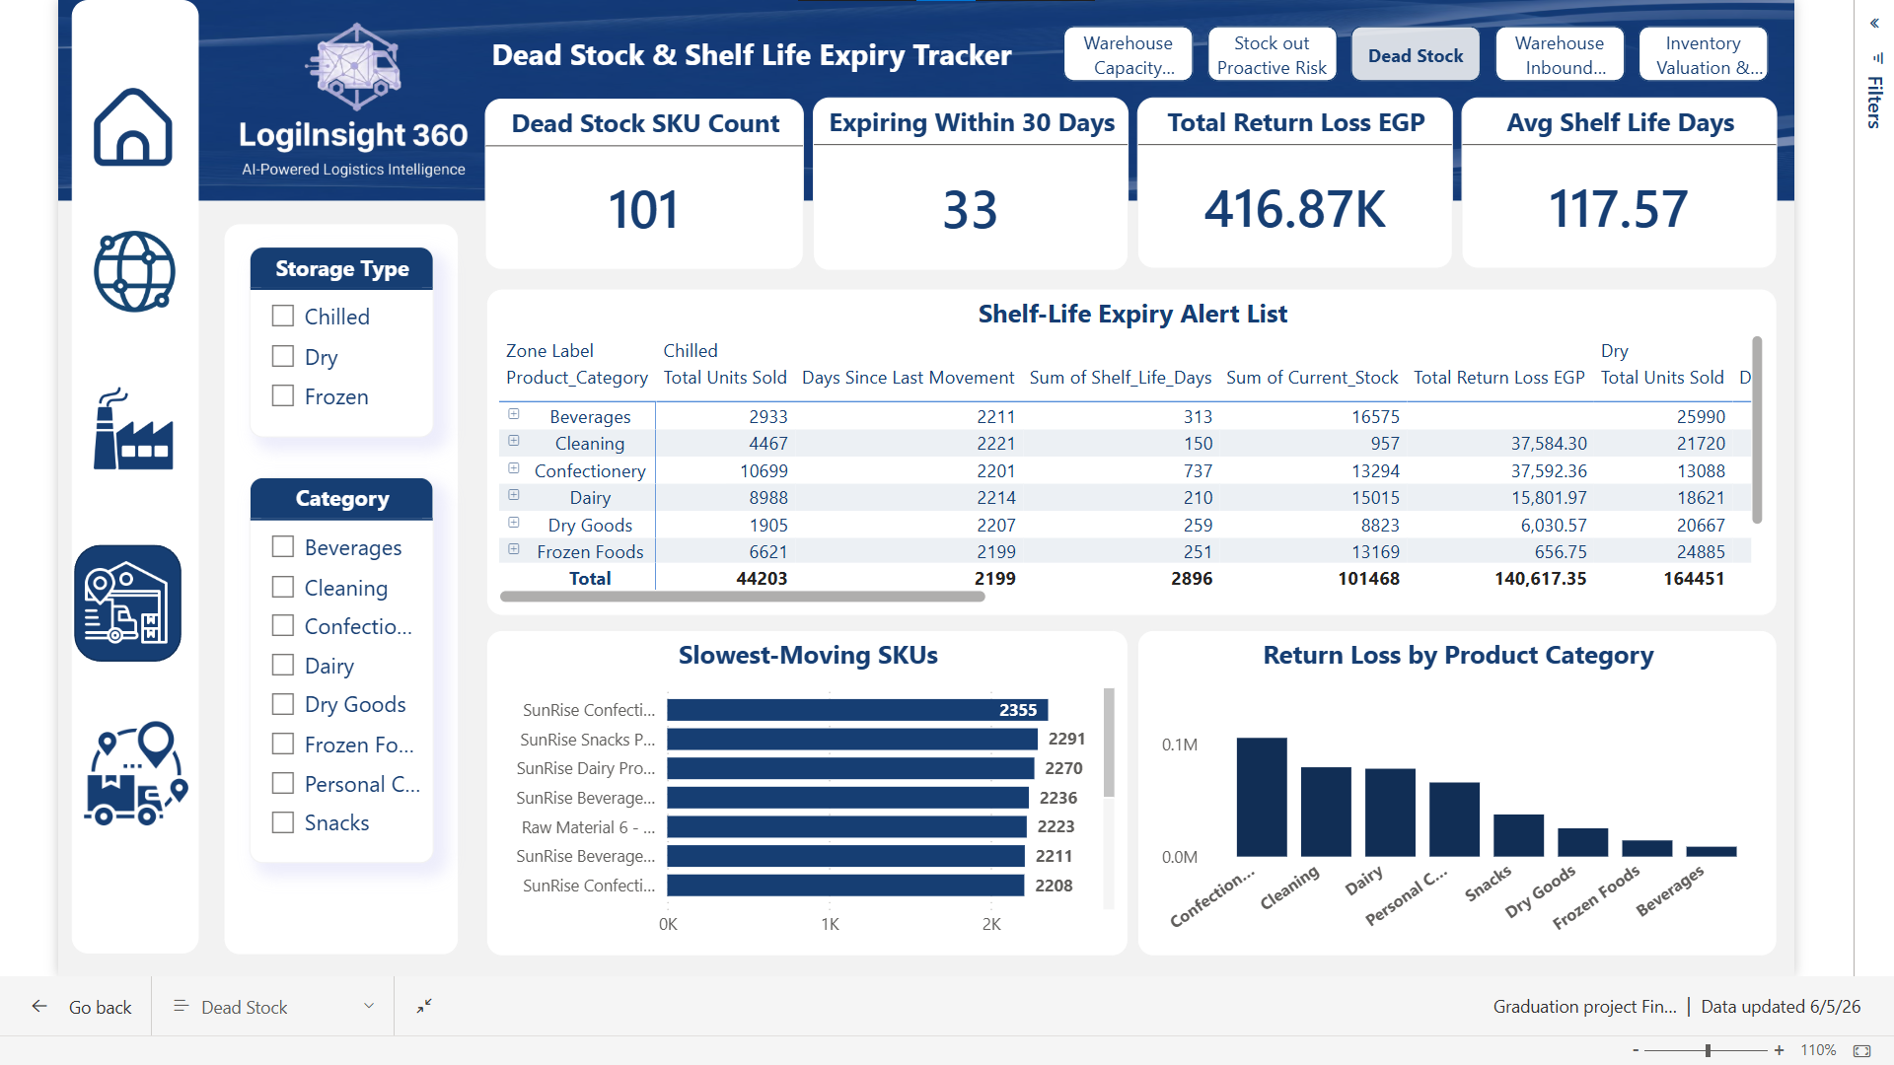

Slide 43
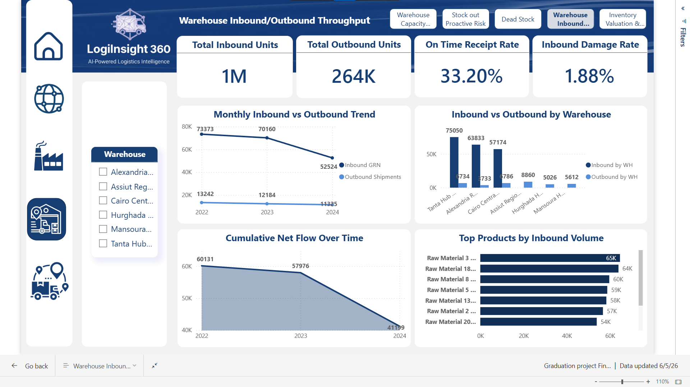

Slide 44
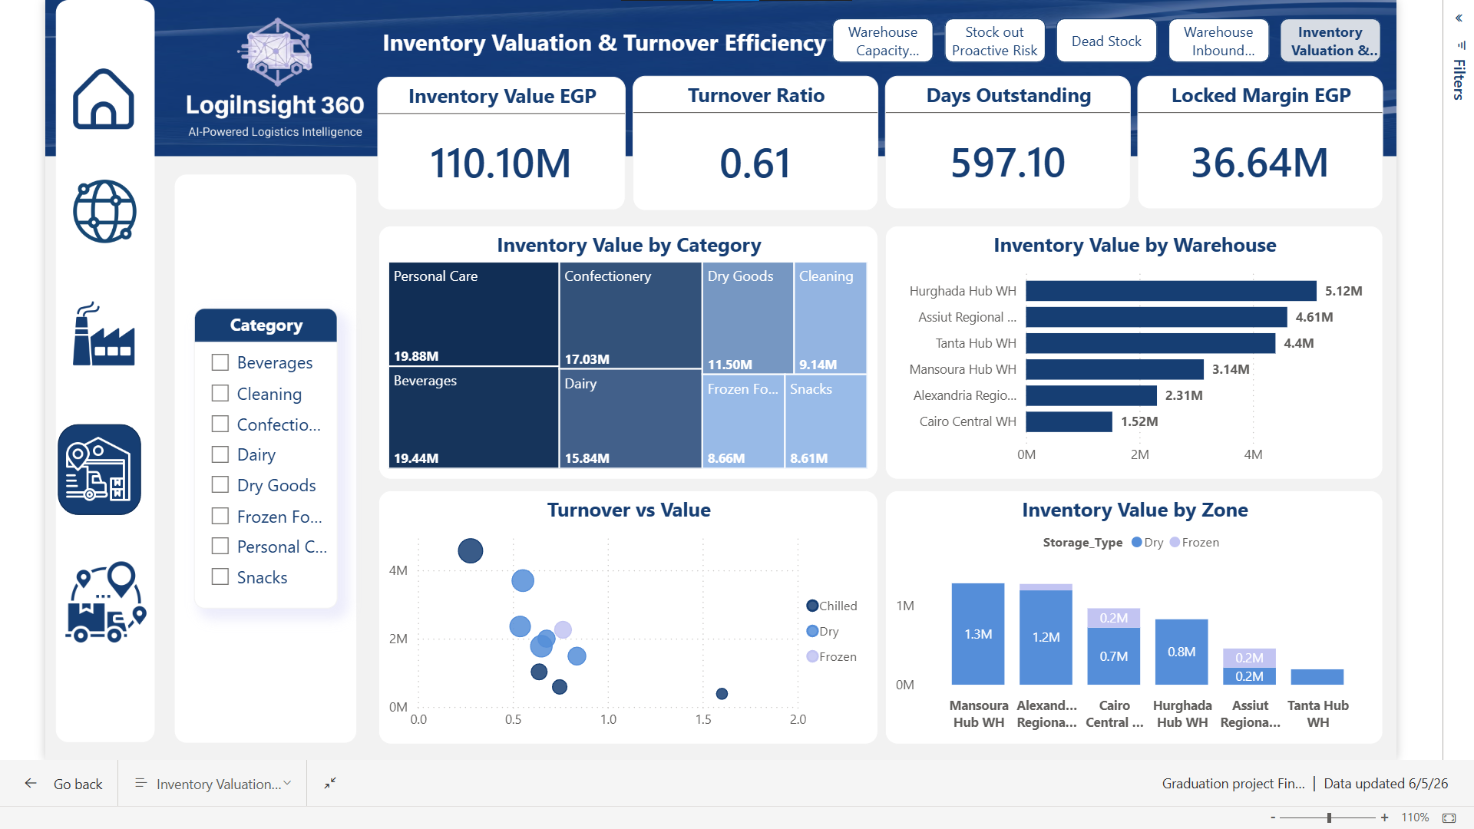

Slide 45
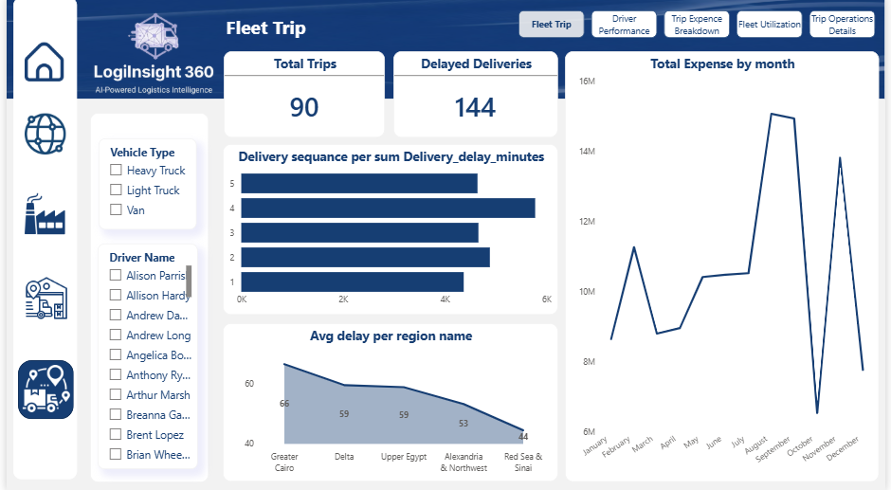

Slide 46
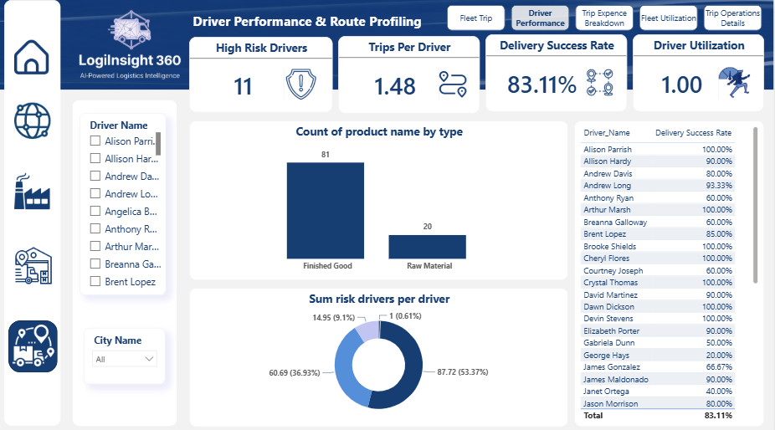

Slide 47
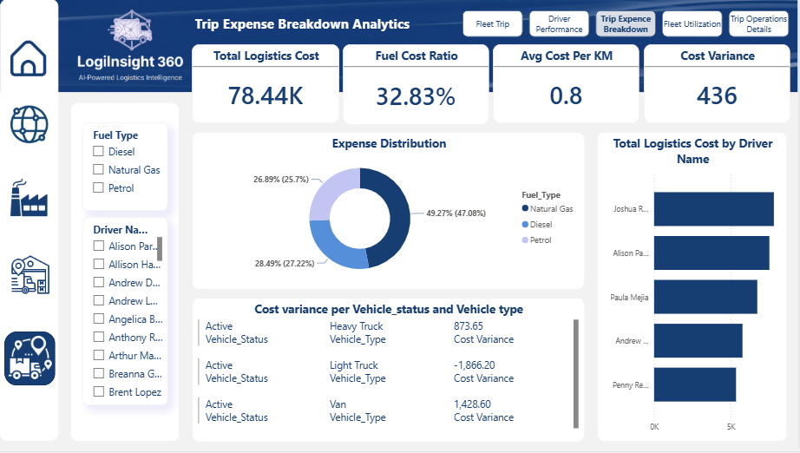

Slide 48
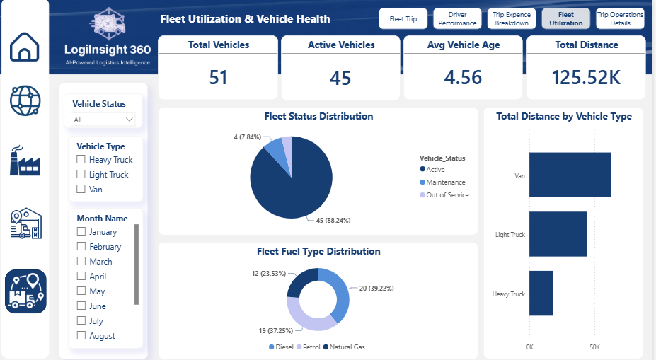

Slide 49
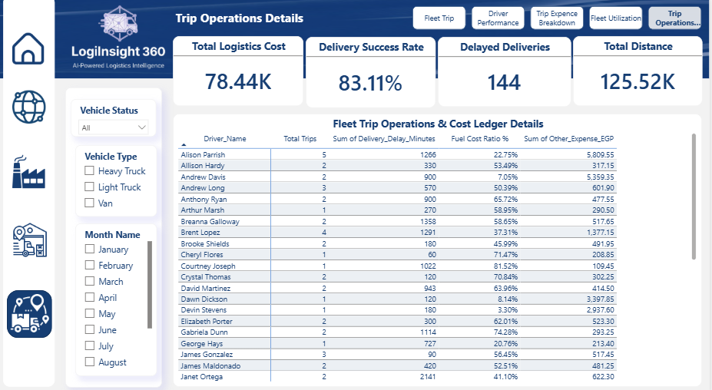

Slide 50

LOGI-INSIGHT-360 WEBSITE

Slide 51
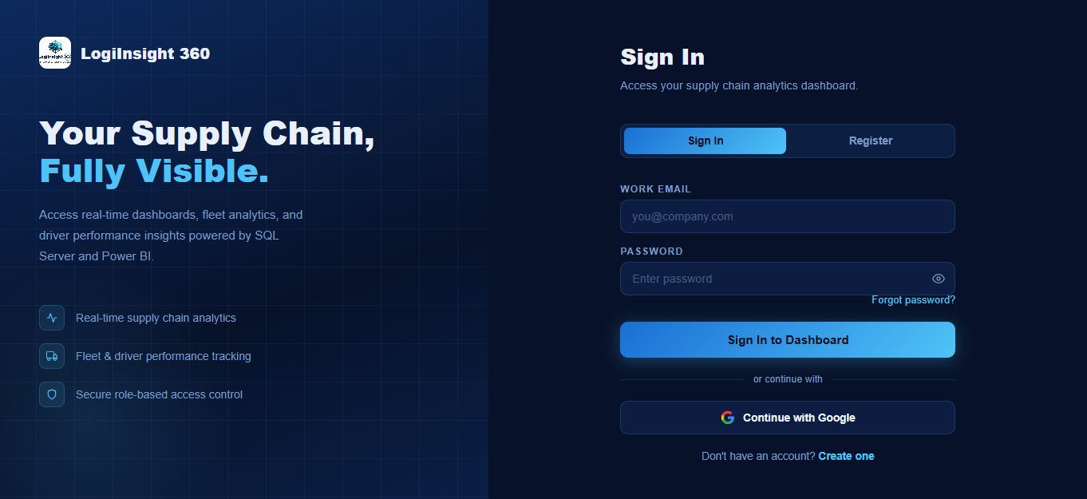

Slide 52
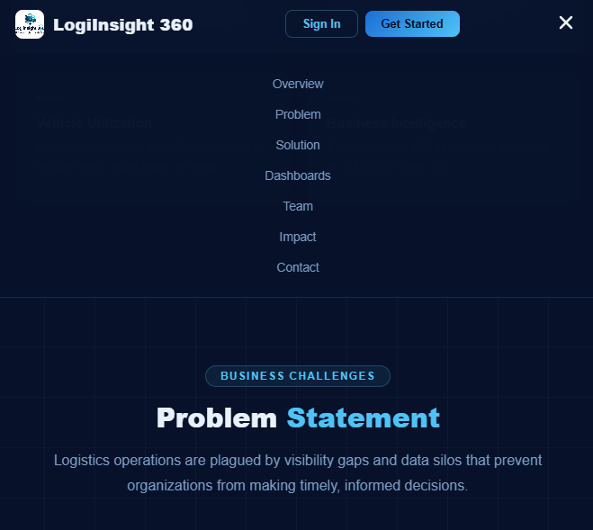

Slide 53
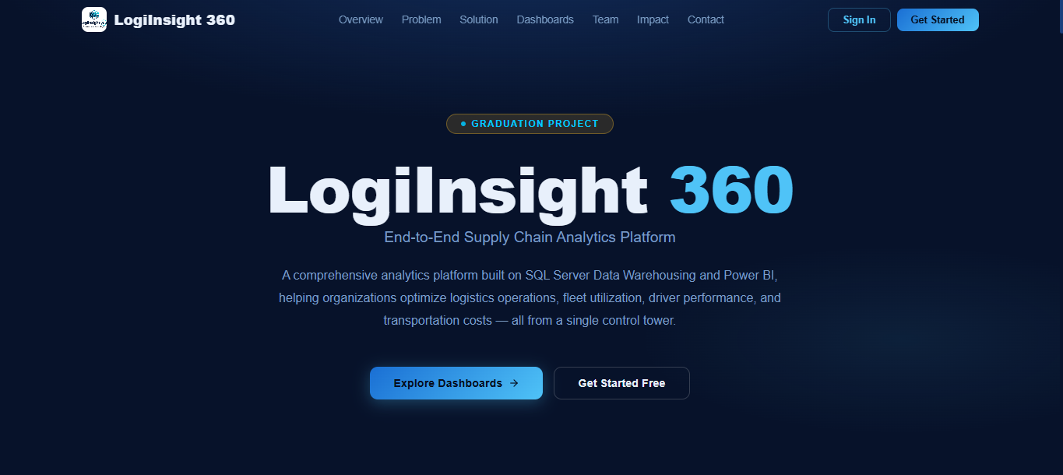

Slide 54
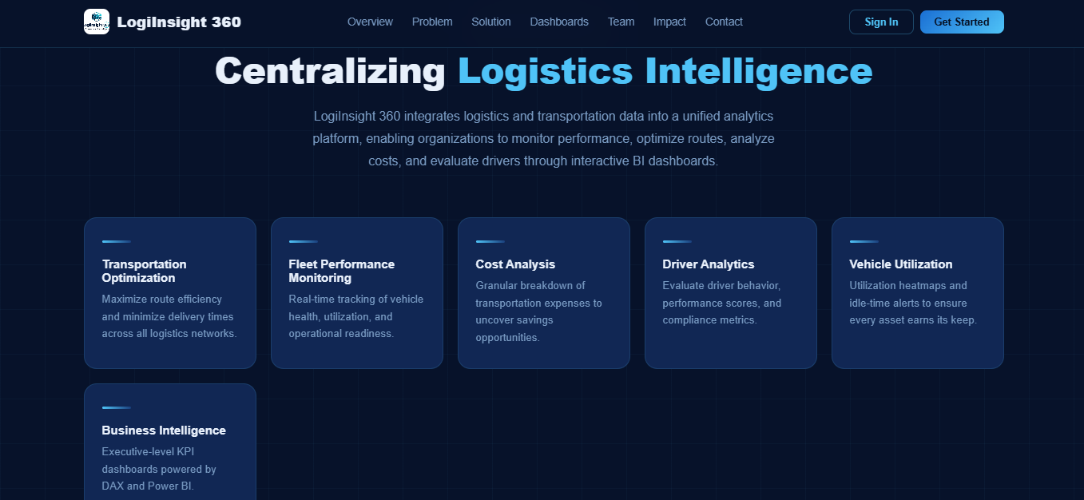

Slide 55
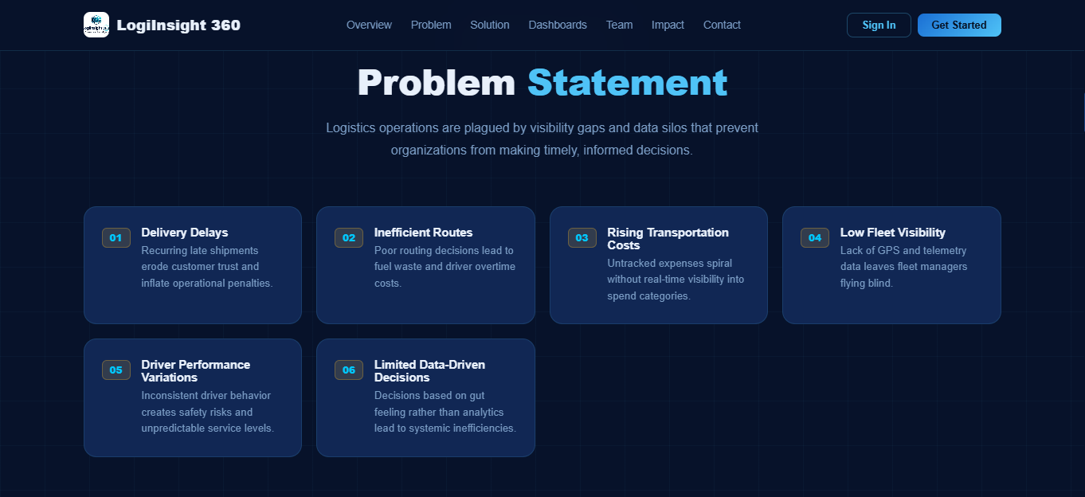

Slide 56
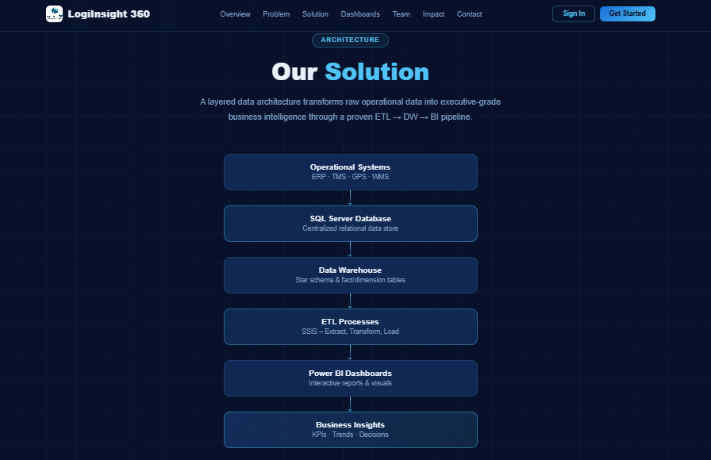

Slide 57
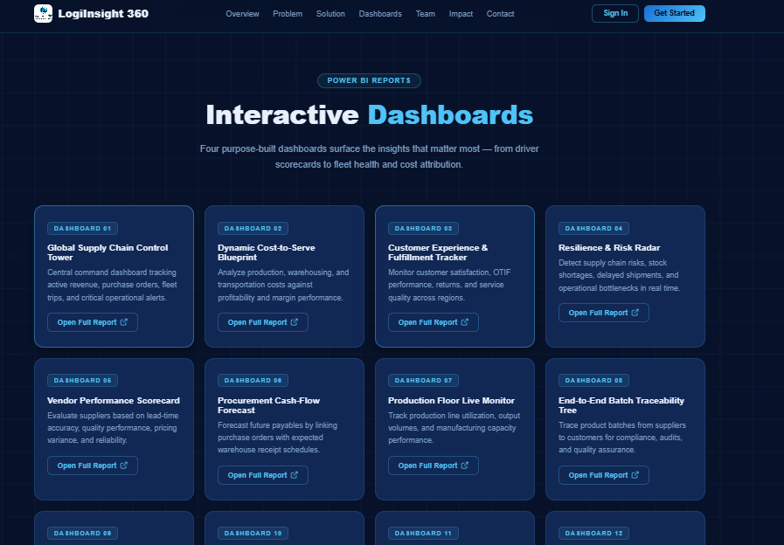

Slide 58
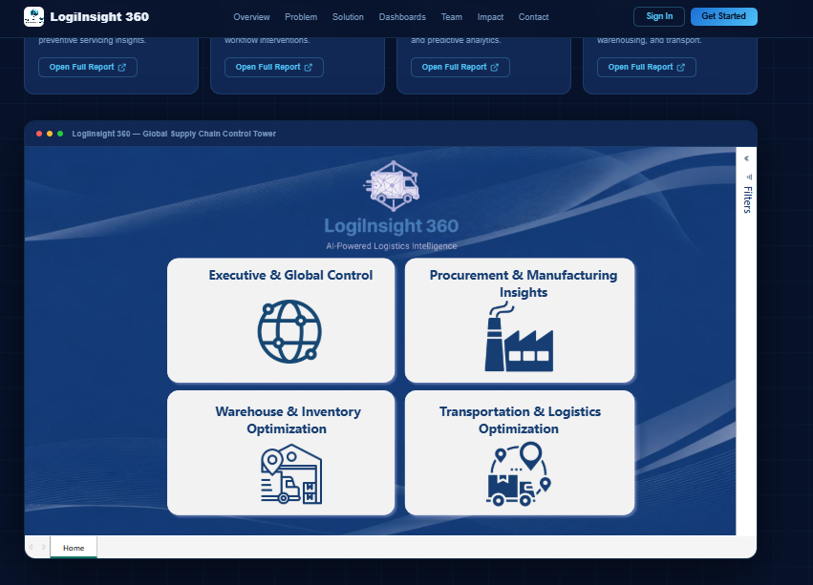

Slide 59
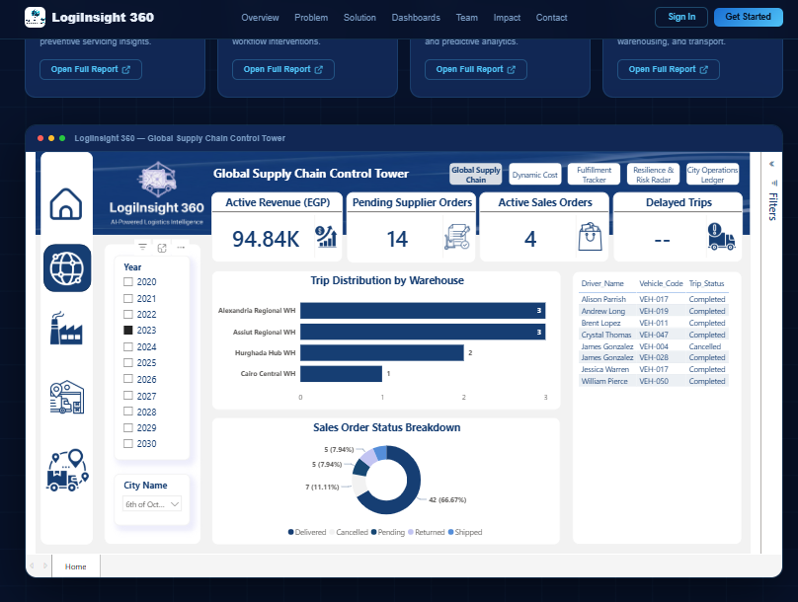

Slide 60
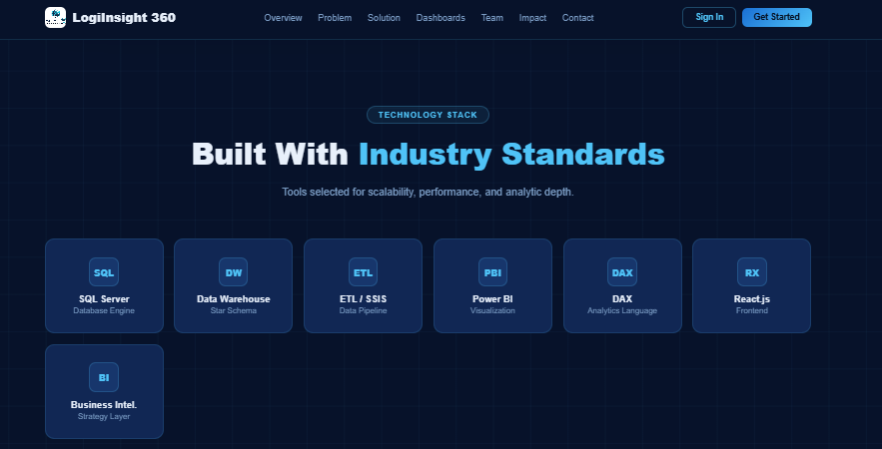

Slide 61


Slide 62


Slide 63


Slide 64
SMART WORKFLOW & AI

Slide 65







SMART WORKFLOW – QUALITY INSPECTION
Quality Inspector
logs failed batch
Warehouse Mgr
approves / reject
Power Apps
Submit to SQL
Recommendation is generated
LLM model is called
01
05
02
04
03

Slide 66


SAMPLE TEST

Slide 67
CONCLUSION
Successfully bridged the Decision Gap between field operations and executive management.
Developed a Modular Cloud Architecture (OLTP/DWH) ensuring zero latency and enterprise scalability.
Proved the power of Agentic AI in turning reactive data into proactive commercial mitigation.
Delivered measurable Business Value by reducing operational waste and fleet blindness.

Slide 68
FUTURE WORK
Hardware Integration: Transition from simulation to physical IoT sensors (Fuel probes, GPS, Vibration).
Prescriptive Logistics: Moving from "Recommendations" to Autonomous Procurement based on AI logic.
Blockchain Traceability: Securing the Vendor-to-Customer loop with an immutable ledger for product origins.
Mobile Deployment: Expanding Power Apps to native iOS/Android for full-scale global field mobility.

Slide 69


THANK YOU
VISIT US
www.log-insight-360.com

